Slide 1
Networks Based on Yelp Reviews https://smsubrahmannian.github.io

Slide 2
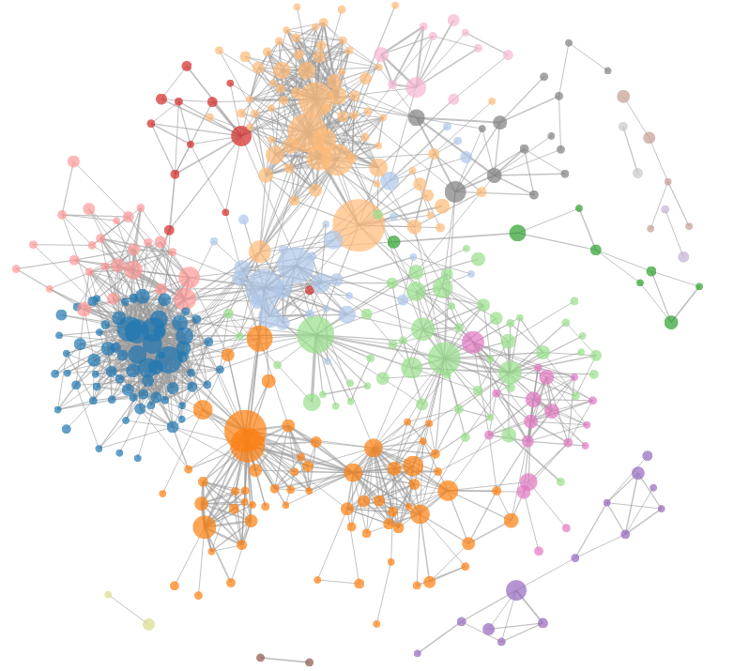

Motivation
Explore network construction driven by unstructured data - like reviewers’ opinions

Slide 3
Project Objectives & Status
Completed the 2 must-have features laid out in the proposal:
Visualization of a network of restaurants
Visualization of a network of the main ideas expressed in reviews
Completed the following optional feature mentioned in the proposal
A slider to allow users to change similarity thresholds for constructing networks

Slide 4
Data
Modeling
Yelp review dataset filtered for restaurants in Nevada
Over 20,000 user reviews
237 restaurants
Built and tuned an LDA model
Constructed 2 undirected and unweighted graphs

Slide 5
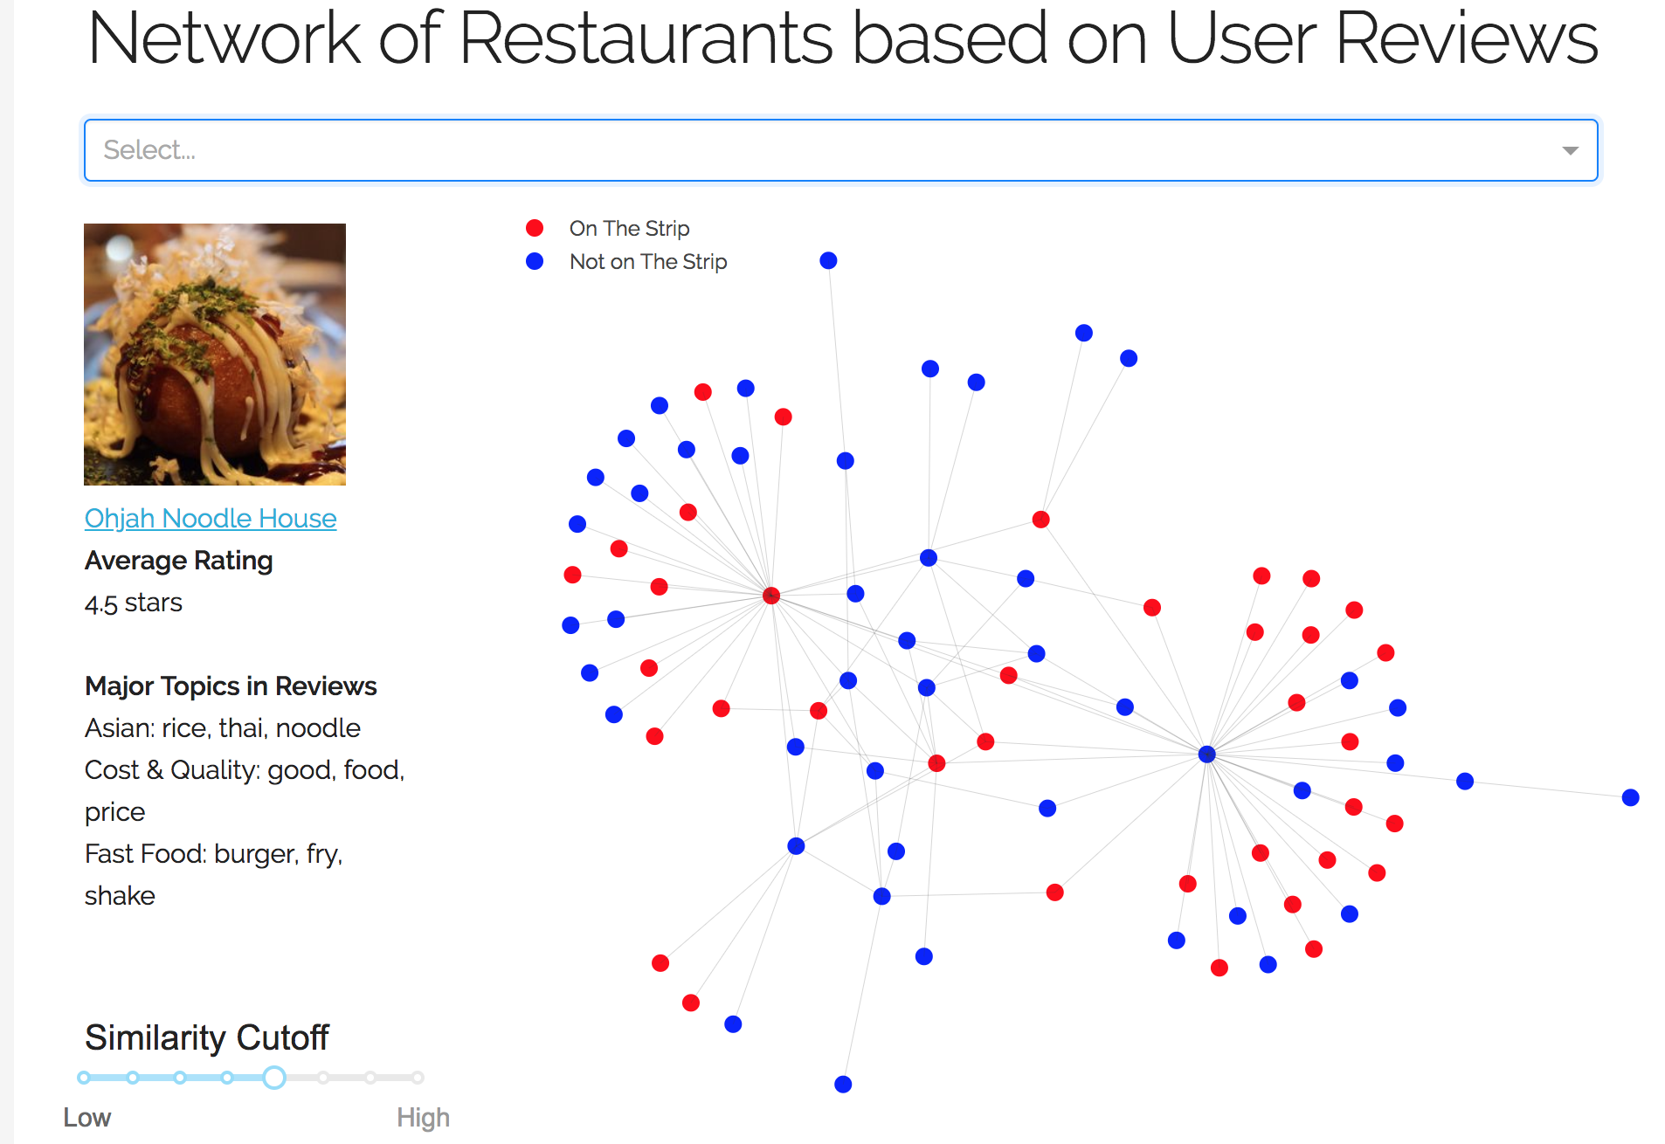
Visualization 1
Allows user to explore a network of restaurants in Las Vegas
Restaurants split into 2 groups depending upon whether they are located on the touristy ‘Strip’ or not
Threshold slider allows watching the network change
At each threshold value, a pre-tuned Fruchterman-Reingold layout spring constant k is used

Slide 6
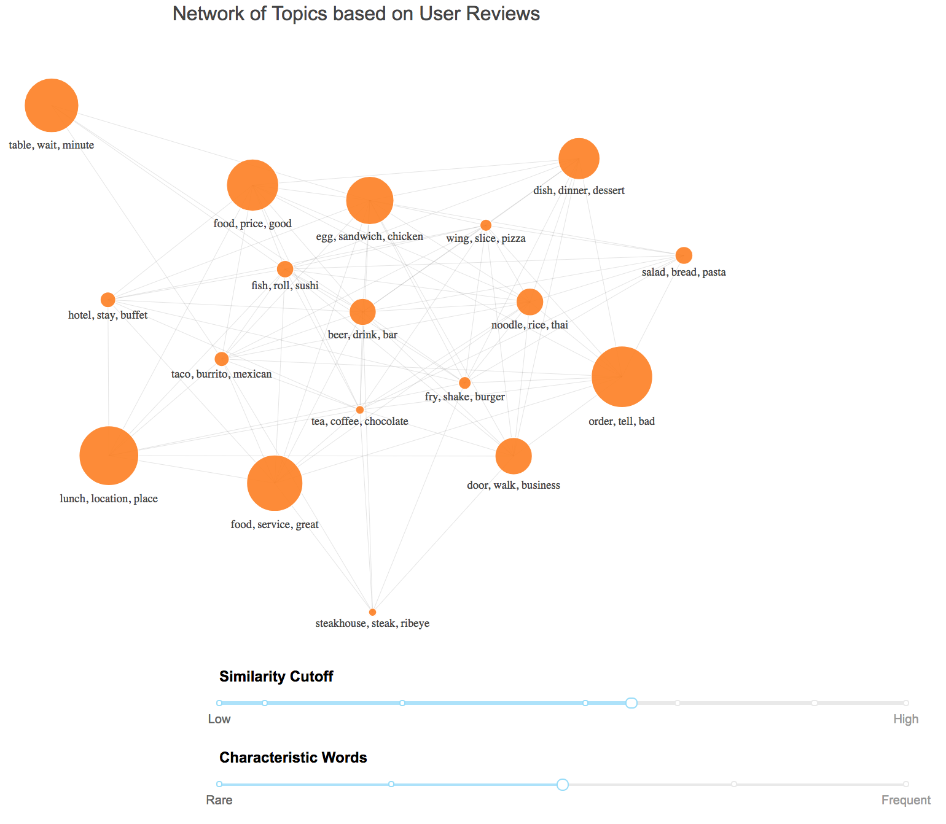
Visualization 2
Allows user to explore a network of topics in reviews
Topics are nodes sized by token contribution
Threshold slider allows watching the network change
2nd slider allows watching the ‘characteristic words’ for each topic change.
Helps better understand what the topics represent
At each threshold value, a pre-tuned Fruchterman-Reingold layout spring constant k is used

Slide 7
Ongoing Work
A server has been set up to host the 2 interactive visualizations on an AWS EC2 instance
The website is being fine-tuned with regard to appearance and written content on the ‘story’

Slide 8
Thank you.

